Slide 1

BEST DINE
Department of Information Technology
Acropolis Institute of Technology and Research
Guided By : Presented By :
Mr. Asif Ali Rachita Soni (0827IT151084)
Sakshi Arya (0827IT151096)
Co-Ordinated By : Shalini Vyas (0827IT151101)
Mr. Praveen Bhanodia Tanmay Porwal (0827IT151116)

Slide 2
OUTLINE
1. Abstract
2. Introduction
3. Scope
4. Problem in existing system
5. System Requirement Analysis
6. System Feasibility
7. System Design
8. Limitations
9. Screenshots
10. Conclusion
11. Future Scope

Slide 3
ABSTRACT
Best Dine is an android application that –
Provides a means to popularize small food shops in the city.
The shop owners can register their shop .
Shop details will be visible to the site users.
Details of newly registered shop are communicated to all the registered users.
Facilitates Online food delivery services

Slide 4
INTRODUCTION
OBJECTIVE
To covers maximum food shops.
Easy availability of various shops details to maximum number of people.
Help shop owners to take feedback about their shop.

Slide 5
SCOPE
Best Dine is applicable anywhere, where internet facility is available.
The users can find all the details of the available shops.
There are five basic users – shop owner , visitor , registered users , admin , operator.

Slide 6
PROBLEMS IN EXISTING SYSTEM
We can’t obtain information about various food shops in the city at one place.
There is no efficient means to popularize a newly opened shop.
All existing means of advertisement are payable.
No efficient means to broadcasting latest offers brought up at the shop.

Slide 7
SYSTEM REQUIREMENT ANALYSIS
PLATFORM SPECIFICATION (Development and Deployment)
Hardware Specification
Client Side:
Processor : PentiumIV
RAM : 256 MB Ram
Browser : Internet Explorer, Mozilla Firefox, Google Chrome
Hard Disk : 2 GB
Operating System : Windows XP/7 etc.

Slide 8
Server Side:
Processor : PentiumIV
RAM : 512 MB Ram
Hard Disk : 10 GB
Operating System : Windows XP/7, etc.
Tools : Glass Fish Server, Mysql, etc.

Slide 9
Software Specifications
Client on internet:
Operating System : Android
Operating System : Windows XP/7 etc.
Database Server: Firebase

Slide 10
Development End:
Android
Java
Firebase
Operating System : Windows XP/7 etc

Slide 11
SYSTEM FEASIBILITY
Economical
The project doesn’t require much advance features.
Economically cheaper.
Two main things required are—
1.Computer (processor of Pentium 4 and above) .
2. Internet connection.
For achieving economical feasibility, we create our project by using available online realtime database

Slide 12
Technical
The work for the project can be done with the existing software technology.
No rigid hardware and software requirements.
The technologies that are used in the project are:
Android
Java
Firebase

Slide 13
Behavioural
The proposed system is easy to operate.
Existing members are not affected in anyway.
Retrieval of information is easy, accurate and fast.

Slide 14
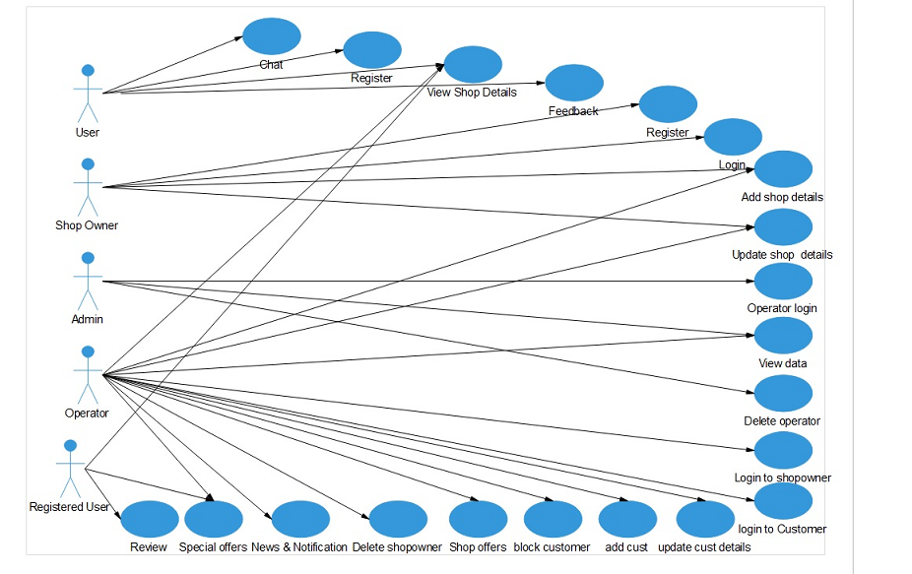
SYSTEM DESIGN
USECASE DIAGRAM
Figure 1: Use case diagram

Slide 15
ACTIVITY DIAGRAMS
USER REGISTRATION
Figure 2: Activity diagram for User registration

Slide 16
USER LOGIN
Figure 3: Activity diagram for User login

Slide 17
WRITE A REVIEW
Figure 4: Activity diagram for review

Slide 18
VIEW SHOP
Figure 5: Activity diagram for view shop

Slide 19
SEARCH SHOP
Figure 6: Activity diagram for search shop

Slide 20
UPDATE SHOP DETAILS
Figure 7: Activity diagram for update shop details

Slide 21
SEQUENCE DIAGRAMS
USER REGISTRATION
Figure 8: Sequence diagram for user registration

Slide 22
USER LOGIN
Figure 9: Sequence diagram for user login

Slide 23
Class Diagram
Figure 10: Class Diagram

Slide 24
LIMITATIONS
Internet requirement is must.
There is no multilingual support.
Only operators can update the database.
Admin has all the authorities.

Slide 25
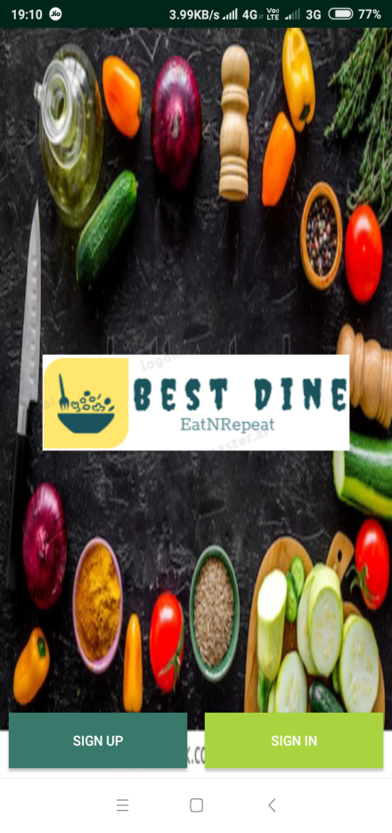
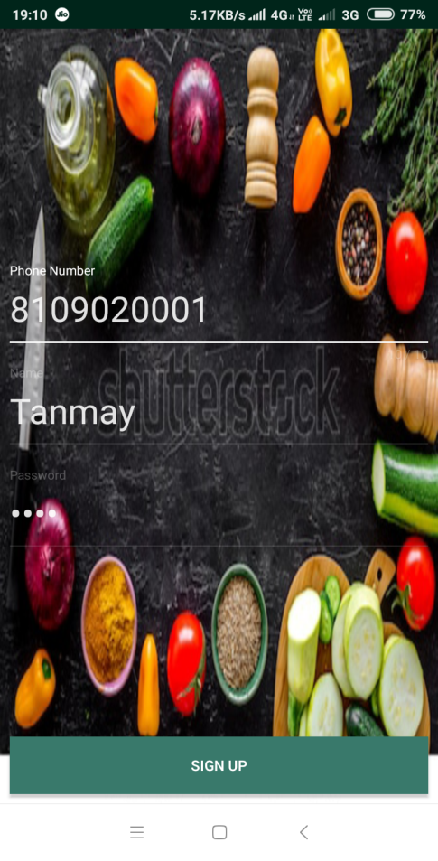
SCREENSHOTS

Slide 26
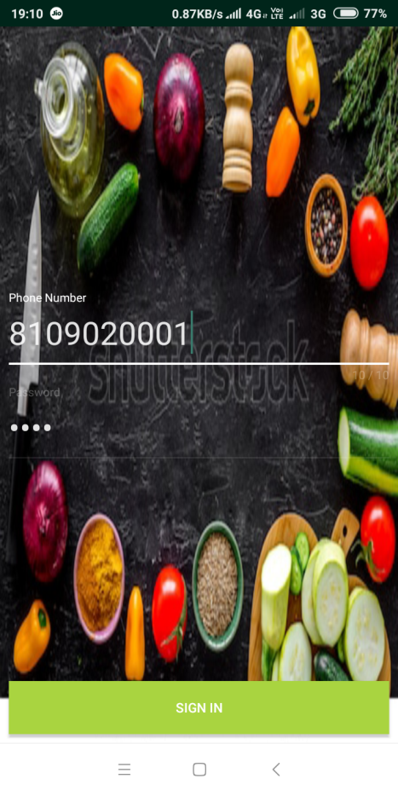
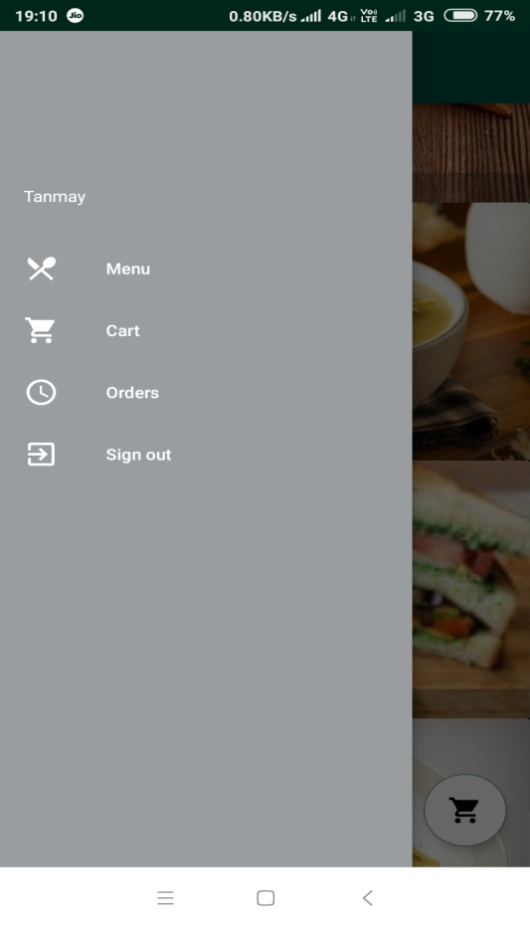

Slide 27
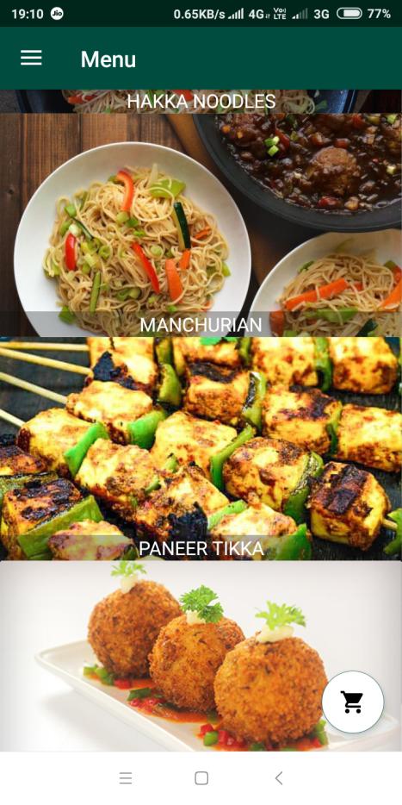
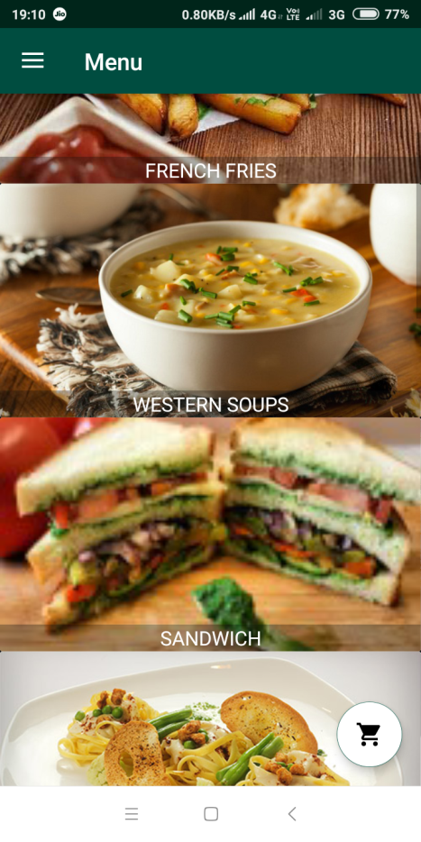

Slide 28
CONCLUSION
The main target of our application is to provide easy accessibility and convenience to customer over internet if they want search for details of food shops across city. Also to provide efficient means of free advertisement to food shop owners. The scalability of our project is large , it can be extended to various cities and can be scaled from small food shops in city to large once.

Slide 29
FUTURE SCOPE
Online transaction.
Map facility.

Slide 30
REFERENCES
Roger S. Pressman “Software Engineering”, Tata McGraw-Hills Education 2009.
Herbert Schildt “Java: The Complete Reference”, Tata McGraw-Hills Education 2011.

Slide 31
Thank You

